Slide 1
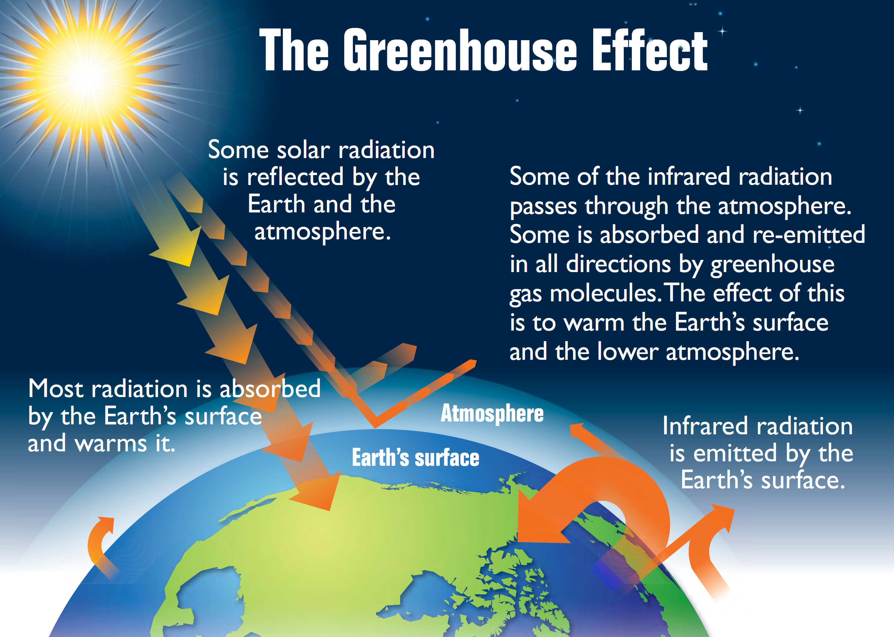
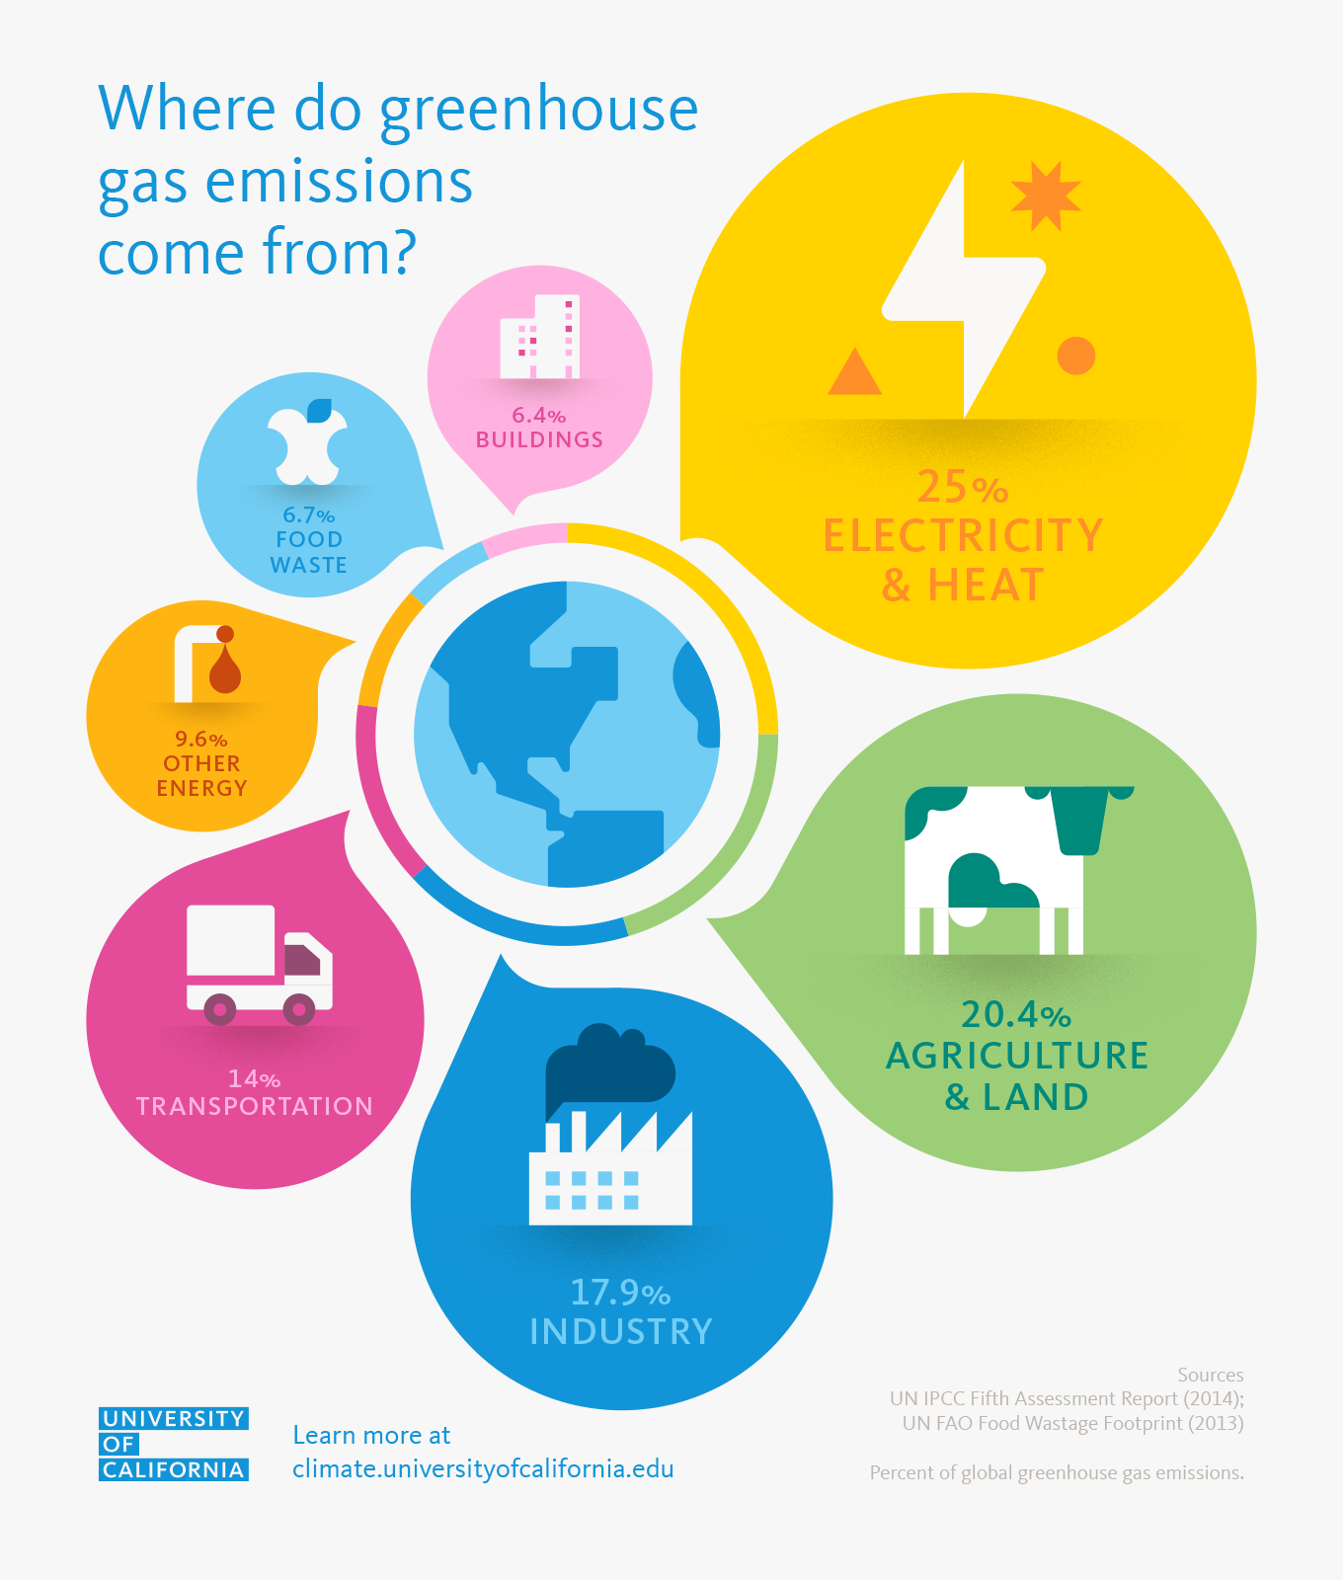
Year 8 Climate Change- Term 1
Knowledge Organiser
Natural factors increasing global climate
There are also natural factors which contribute to increased global warming:
Orbital changes - the Earth has natural warming and cooling periods caused by Milankovitch cycles or variations in the tilt and/or orbit of the Earth around the Sun (Wobble, roll and stretch theory).
Volcanic activity - during a volcanic eruption carbon dioxide is released into the atmosphere.
Solar output - there can be fluctuations in the amount of radiation from the sun. If there is high amount emitted there will be an increase in Earth's temperatures.
Human factors increasing global climate change
Some human activities increase the greenhouse gases in the atmosphere:
Burning fossil fuels, eg coal, gas and oil - these release carbon dioxide into the atmosphere.
Deforestation - trees absorb carbon dioxide during photosynthesis. If they are cut down, there will be higher amounts of carbon dioxide in the atmosphere.
Dumping waste in landfill - when the waste decomposes it produces methane.
Agriculture - agricultural practices lead to the release of nitrogen oxides into the atmosphere.
Key Word | Definition
Greenhouse gas | A gas which contributes to the greenhouse effect
Climate | The long term weather conditions over a large area.
Weather | The day-to-day conditions of the atmosphere, one day it can be dry and sunny and the next day it may rain
Precipitation | Rainfall, snow, hail or sleet.
Biodiversity | The number or variety of different species in a given area
Economic | Relating to trade, money and the creation of wealth
Enhanced | To increase or make bigger.
Equator | The center line on the earth. Halfway between the N and S pole.
Albedo | The reflectivity of the earth's surface.
Fossil Fuel | Gas oil or coal. A non- renewable energy source which is burned.
Deforestation | The removal of tress, forest and woodland.

